Slide 1
BIA6306_Final_EricLong
File created on: 12/5/2021 12:34:23 PM

Slide 2
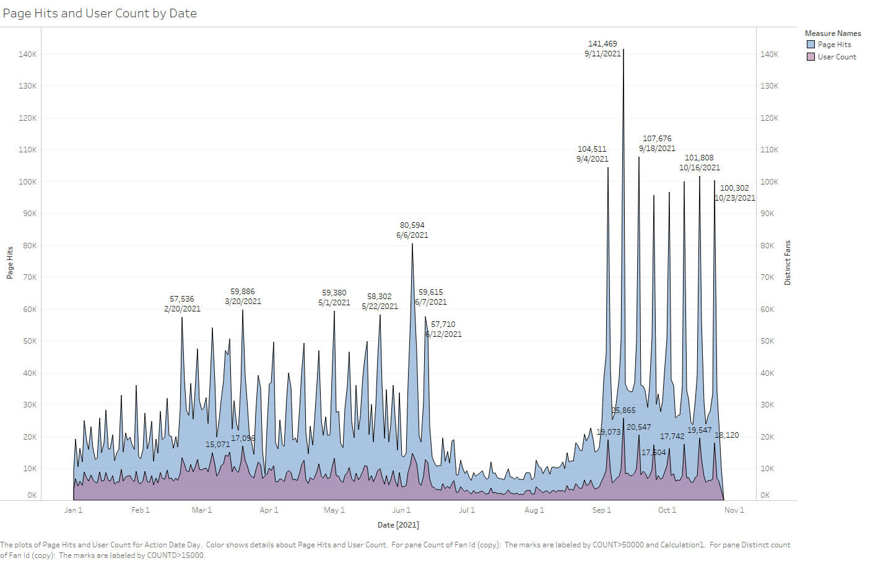

Slide 3
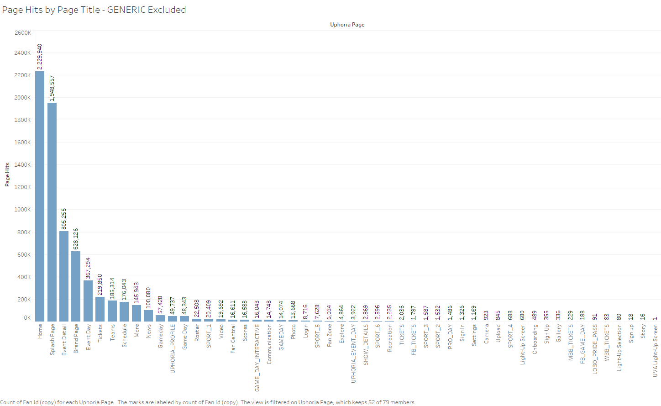

Slide 4
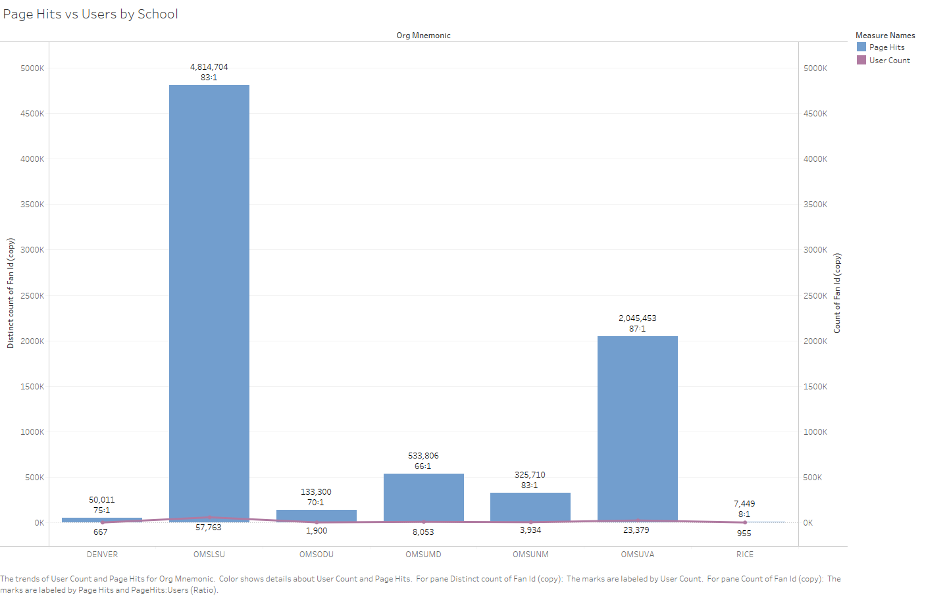

Slide 5
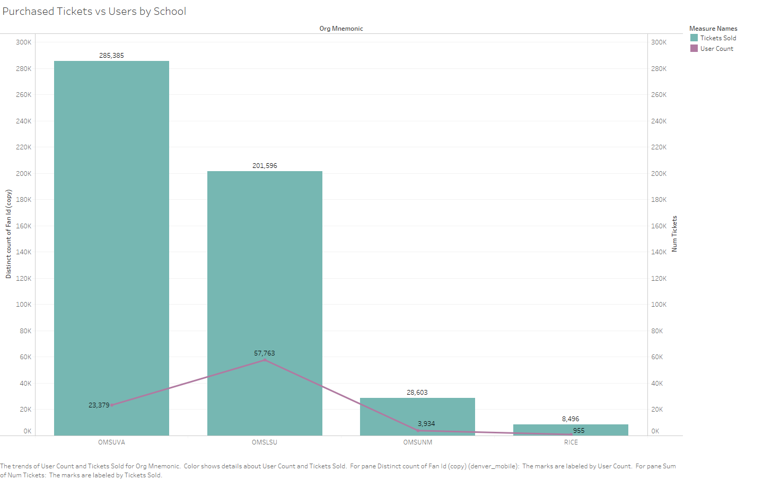

Slide 6
